Slide 1


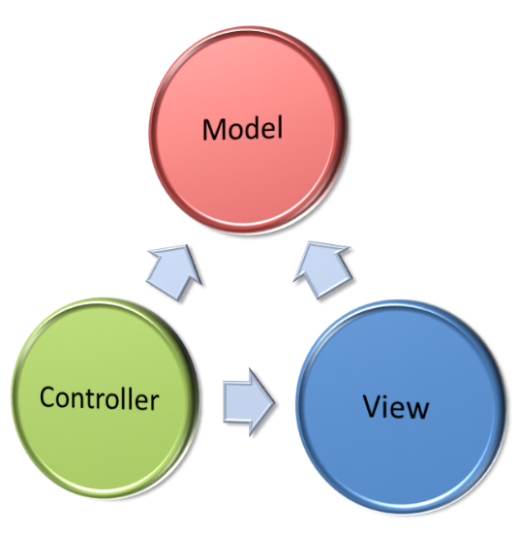
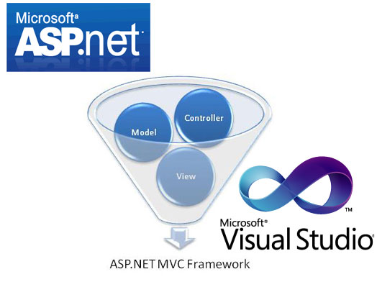

ASP.NET MVC
Course Program, Trainers, Evaluation, Exams, Resources
ASP.NET MVC
SoftUni Team
Technical Trainers
Software University
http://softuni.bg

Slide 2

Table of Contents
Course Objectives
Course Program
Trainers Team
Examination
Learning Resources

Slide 3
Level #3 at the Software University
Databases
10 times + exam + TW
4 weeks * 3 times
DB Apps
8 times + exam + TW
3 weeks * 3 times
WS & Cloud
8 times + exam + TW
3 weeks * 3 times
Web Dev.
4 times + exam
2 weeks * 2 times
MVC
15 times + exam + TW
5 weeks * 3 times

Slide 4

ASP.NET MVC
Course Objectives & Program

Slide 5


Course Program
Course Introduction
ASP.NET MVC Introduction
ASP.NET MVC Essentials
ASP.NET MVC Architecture
Working with Data
ASP.NET Identity
AJAX in ASP.NET MVC
SignalR

Slide 6
Course Program
ASP.NET Web Security
Caching Data
ASP.NET MVC Controls
Advanced Topics
Visual Studio 2015 & ASP.NET MVC 6

Slide 7

Warning: Not for Beginners
The "ASP.NET MVC" course is NOT for beginners
Requirements:
"Programming Basics" course
"Object-Oriented Programming (OOP)" course
"Databases" course
"Database Applications" course
"Web Development Basics" course
Preliminary skills required!

Slide 8

The Trainers Team

Slide 9
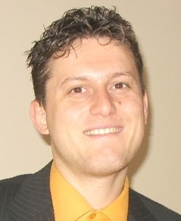
Trainers Team
Svetlin Nakov, PhD
Training & Inspiration Manager @ Software University
20+ years software development experience
10+ years experience as trainer
Author of 7 programming books
Speaker at hundreds of events
Web site & blog: www.nakov.com

Slide 10
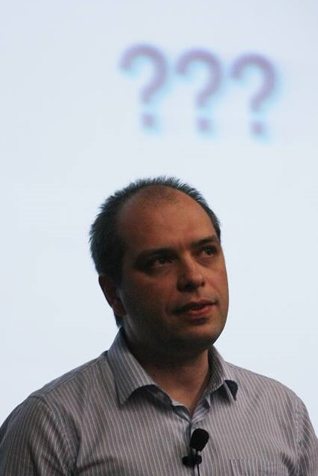
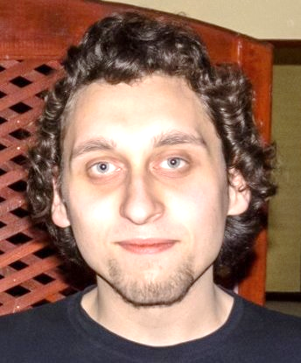
Trainers Team (2)
Stamo Petkov
Senior Software Developer @ Information Services Plc.
Trainer @ InfoStart and i-learning.bg
Yordan Darakchiev
Technical trainer @ Software University
Top performing graduate from the Telerik Software Academy (2013)
Top performing student at the Software University (2014)

Slide 11

ASP.NET MVC: More Details
Duration, Languages, Technologies

Slide 12


Training Duration – ASP.NET MVC
Lectures: ~ 40 hours (onsite + YouTube videos)
Practical exercises (in class): ~ 30 hours
Homework: ~ 40-60 hours
Schedule: October – November 2015
Teamwork Defense: 5 November 2015
Practical Exam: 6 November 2015

Slide 13



Why English?
Why the slides are in English?
English is the native language of the software engineers
Specific terminology should be in English
Translations are inaccurate and funny
Just learn English!
No excuses

Slide 14
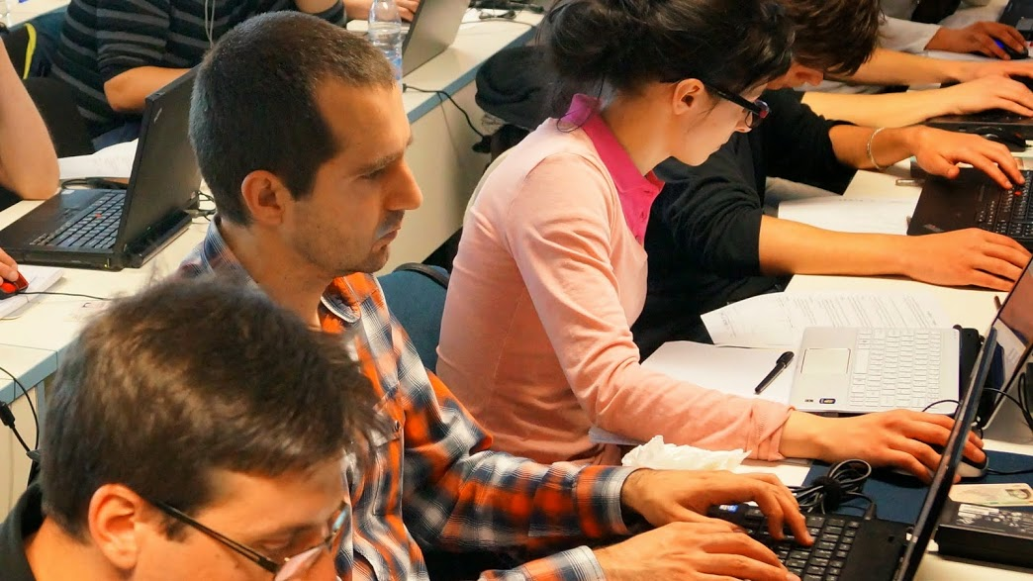


ASP.NET MVC
Evaluation Criteria

Slide 15

Scoring System for the "ASP.NET MVC"
Practical Exam – 80%
Teamwork – 10%
Homework + Evaluation – 5% + 5%
Presence in class: 5% (onsite students only)
Bonuses: up to 10%

Slide 16

The Practical Exam
ASP.NET MVC practical exam
Design and implement a Web application
Use ASP.NET MVC
Follow the principles of high-quality-code
Practical exam evaluation
Manual checking
The total score is given by the SoftUni team

Slide 17

Homework Assignments
Doing your homework is very important!
Programming can only be learned through a lot of practice!
You should write code every day!
Each lecture is followed by a few exercises
Try to solve them in class
The rest are your homework
Homework assignments are due in 1-2 weeks after each lecture
Submission will be accepted through our web site: softuni.bg

Slide 18

Homework Peer Reviews
Give feedback to a few random homework submissions
Students submit homework anonymously
Please exclude your name from the submissions!
For each homework submitted
Students evaluate 3 random homeworks
From the same topic, after the deadline
Give written feedback, at least 200 characters
Low-quality feedback → report for punishment
Everyone will get feedback for their homework

Slide 19








Resources
What We Need Additionally?

Slide 20

Course Web Site & Forums
The ASP.NET MVC course web site:
Register for the "Software University Forum":
Discuss the course exercises with your colleagues
Find solutions for all course exercises
Share source code / discuss ideas / help each other
https://softuni.bg/trainings/1230/asp-net-mvc-october-2015
https://softuni.bg/forum

Slide 21



ASP.NET MVC Slides and Videos
All lecture slides, videos, homework assignments, projects and other resources are open content, available for free
Visit the course web site to access the course resources

Slide 22
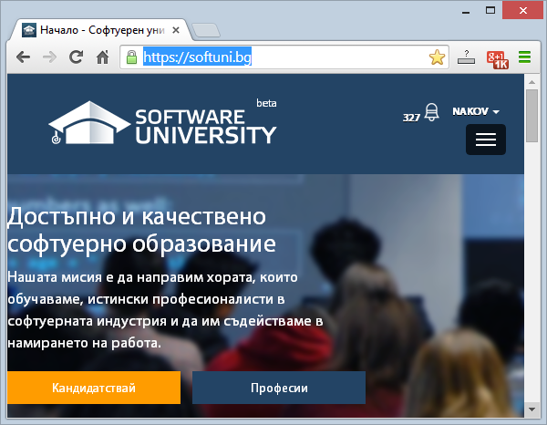
Software University Learning System (SULS)
Software University Learning System (SULS)
www.softuni.bg
Important resource for students
Homework submissions
Homework check-up
Exams and results
Reports about your progress
…

Slide 23
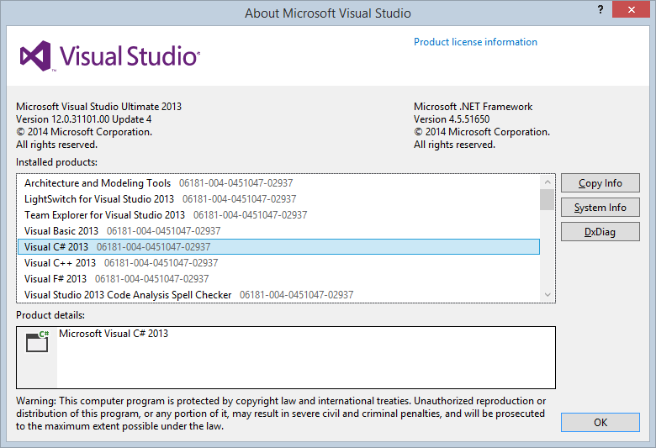
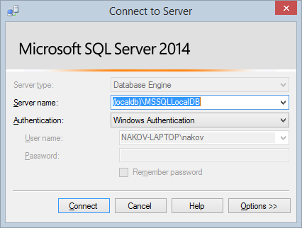
Recommended Software
Microsoft Visual Studio 2015
Use the latest Visual Studio!
You may also use Visual Studio 2013 Update 4
Microsoft SQL Server 2012 / 2014

Slide 24









ASP.NET MVC Course Introduction
https://softuni.bg/trainings/1147/Data-Structures-June-2015

Slide 25
License
This course (slides, examples, labs, videos, homework, etc.) is licensed under the "Creative Commons Attribution-NonCommercial-ShareAlike 4.0 International" license
Attribution: this work may contain portions from
"Fundamentals of Computer Programming with C#" book by Svetlin Nakov & Co. under CC-BY-SA license
"Data Structures and Algorithms" course by Telerik Academy under CC-BY-NC-SA license

Slide 26






Free Trainings @ Software University
Software University Foundation – softuni.org
Software University – High-Quality Education, Profession and Job for Software Developers
softuni.bg
Software University @ Facebook
facebook.com/SoftwareUniversity
Software University @ YouTube
youtube.com/SoftwareUniversity
Software University Forums – forum.softuni.bg

